Slide 1
Baptist Covenant Theology
A Biblical Framework for understanding and Savoring God’s Unfolding Redemptive work in HIstory
Part 8: Responding to New Covenant Theology

Slide 3
What Is New Covenant Theology?
Sees itself as a middle ground between covenant theology and dispensationalism
Appeals to Baptists in the Reformed tradition who have traditionally called themselves “Sovereign Grace Baptists”
A reaction to the perception that covenant theology leads to infant baptism

Slide 4
What Does NCT Teach?
Agrees with CT that the church is the fulfillment and continuation of Israel
Agrees with CT that there is one way of salvation in both Old and New Testament, flowing from the new covenant
Agrees with Baptist CT in rejecting one covenant of grace with two or more administrations

Slide 5
How Does NCT Differ from Confessional Baptist CT?
All OT law abolished unless re-established by Christ in the New Testament. “Law of Christ” applies in the NT.
In practice, this involves a denial of the Christian Sabbath
Often leads to a denial that the Lord’s Day is a special day for Christians
Potentially takes away many helpful OT instructions because they aren’t repeated in the NT
Often denies the covenant of works
Sometimes denies that Christ’s life of obedience is imputed to believers.

Slide 6
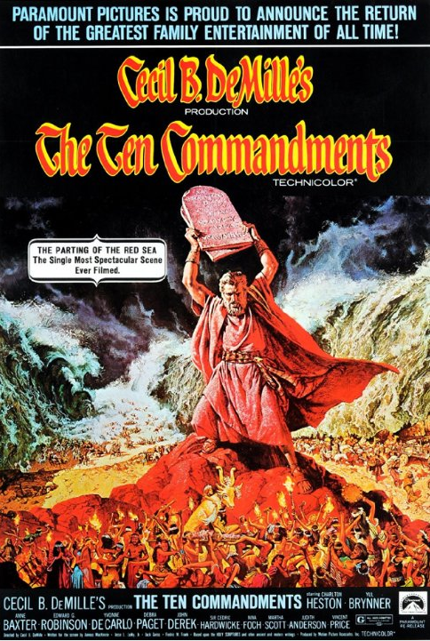

Slide 7
How Does the New Covenant Change the Believer’s View of the Law?
Hebrews 8:10 For this is the covenant that I will make with the house of Israel after those days, declares the Lord: I will put my laws into their minds, and write them on their hearts, and I will be their God, and they shall be my people.
What laws does this refer to, and how do we know?

Slide 8
How Does the NT Interpret the 10 C’s?
1 ¶ Children, obey your parents in the Lord, for this is right. 2 “Honor your father and mother” (this is the first commandment with a promise), 3 “that it may go well with you and that you may live long in the land.” Eph. 6:1-3

Slide 9
What Law Is Revealed to Gentiles?
Rom. 2:12 For all who have sinned without the law will also perish without the law, and all who have sinned under the law will be judged by the law. 13 For it is not the hearers of the law who are righteous before God, but the doers of the law who will be justified. 14 For when Gentiles, who do not have the law, by nature do what the law requires, they are a law to themselves, even though they do not have the law.
21 you then who teach others, do you not teach yourself? While you preach against stealing, do you steal? 22 You who say that one must not commit adultery, do you commit adultery? You who abhor idols, do you rob temples?

Slide 10
NCT and Baptist Confessions: A Cautionary Tale
Often uses the First London Baptist Confession (1644/1646)
The earlier confession is much shorter and does not have an explicit statement concerning the law.
However, there is no contradiction between the two confessions.
Many of the same individuals and churches were involved in producing both confessions.
Claims that the 1689 Confession was compromised—followed the Presbyterian Westminster Confession too closely out of fear of persecution.
The authors state clearly their reasons for a new confession based on the Westminster:
The first confession wasn’t readily available.
Many more had embraced the same truth.
“In those things wherein we differ from others we have expressed ourselves with all candor and plainness.”
“We have no itch to clog religion with new words but…acquiesce in the form of sound words…used by others.”
The confession was published and adopted both in and out of persecution within a 12-year period.
Major and minor changes were made compared to the Westminster that reflect great courage as well as theological discernment.

Slide 11
NCT and Baptist Confessions: A Cautionary Tale
A lack of confessional discipline has opened up NCT to a number of errors in their movement.
Confessional Baptist covenant theology might have diminished the unwarranted fear of leading to infant baptism.

